Slide 1
Companies and services
05. Comparatives

Slide 2
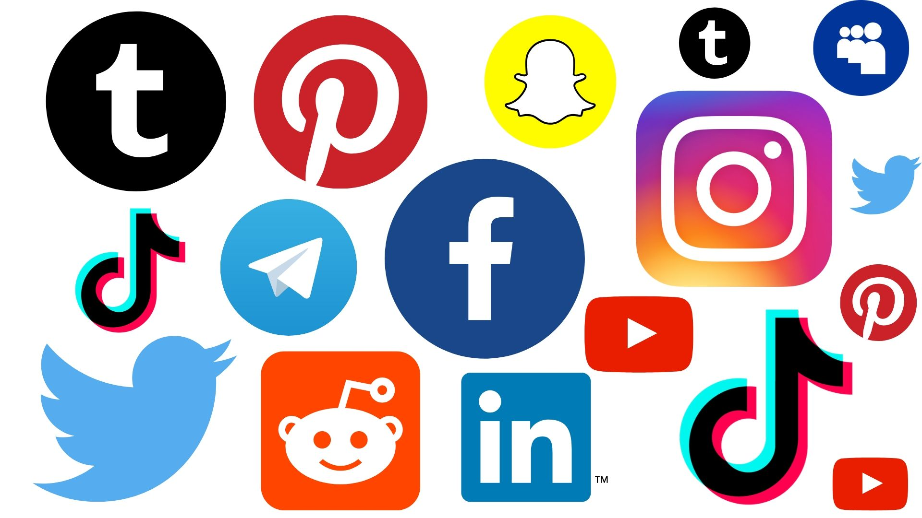


Companies and services
What services do you use?
What companies do you know that provide these services?
Which one do you prefer? Why?

Slide 3
Comparatives
We use comparative adjectives when we compare two people, objects or events. For adjectives of one syllable or two syllables, the comparative form is: adjective + er + than
Movistar is cheaper than Telcel
Spelling Rules
For adjectives that end in e, we just add r.
nice ➞ nicer
For adjectives that end in consonant-vowel-consonant, we double the last letter and add er.
big ➞ bigger
For adjectives ending in y, we change the y to i and add er.
pretty ➞ prettier
Irregular Forms
good ➞ better than
bad ➞ worse than

Slide 4
Complete with the correct comparative
AT&T provided a ______ service than Telcel. (Good)
This new phone has a ______ processor than the previous model. (Fast)
The customer support here is ______ than in the other company. (Nice)
The delivery was ______ than last time. (Quick)
Chipotle is ______ than Taco Bell. (Tasty)
Infinitum is ______ than Cablemas. (Slow)
Marriot is ______ than the Ritz. (Cheap)
The new office is ______ than the old one. (Cold)
The prices in HEB are ______ than in Walmart. (High)
This protein will make you ______. (Strong)
Notes:
AT&T provided a better service than Telcer.
This new phone has a faster processor than the previous model.
The customer support here is nicer than in the other company.
The delivery was quicker than last time.
Chipole is tastier than Taco Bell.
Infinitum is slower tan Cablemas.
Marriot is cheaper than the Ritz.
The new office is colder than the old one.
The prices in HEB are higher than Walmart.
This protein will make you stronger.

Slide 5
Comparatives
For adjectives of two syllables not ending in y and adjectives of three or more syllables, the comparative form is: more + adjective + than
The old company used to give a more satisfactory service than the new one.
Tik tok is more entertaining than Facebook.
Pinterest is more creative than Instagram.

Slide 6
Compare services and companies
efficient | expensive | personalized | appealing
reliable | elegant | supportive | interesting
extensive | advanced | user-friendly | competitive
popular | beautiful | unusual | romantic
Example:
Waze is more efficient than Google Maps.
iPhone has a more user-friendly interface than Samsung.

Slide 7

What company do you use to…? And why?
Buy groceries
Buy medicines
Buy online
Have internet
Social network
Watch movies and series
Buy clothes
Notes:
Compare companies and their services.

